Slide 1


Predicting Olympic Results
By: Rohan Giri, Jennifer Gonzalez, Sameer Khan, Kristen Lowe, María Laura Peña, Scott Stempak
Notes:
ML

Slide 2
Table Of Contents
1
2
3
Intro / Data Cleaning and Merging
Exploratory Data Analysis
Machine Learning Models
Notes:
Rohan

Slide 3


1
Intro / Data Cleaning and Merging

Slide 4


To what extent does a country’s resources impact its performance at the Olympics?

Slide 5




Datasets from Kaggle
Olympic Summer & Winter Games, 1896-2022
World GDP by Country: 1960-2022
Country Population from 1960 to 2022
Countries of the World
medal counts, host country, etc.
GDP by year
population by year
area in sq. km., region, coastline ratio

Slide 6

Data Cleaning and Merging
Clean
mapped country names
pivoted data frames
removed missing values
Resulting Variables
country
year
medal count (gold, silver, bronze)
host country
game season (winter/summer)
GDP
population
population density
region
area (sq. km.)
coastline (coast-to-area ratio)
GDP per capita
host country status (binary)
Merge
olympics + GDP
+ population
+ other country resources
feature engineering

Slide 7
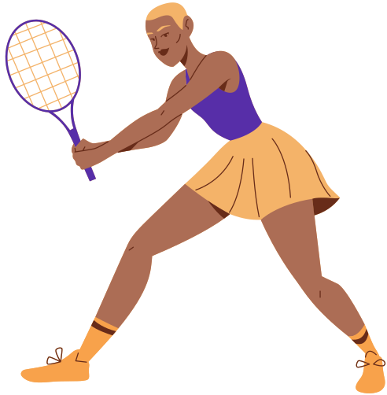
2
Exploratory Data Analysis

Slide 8
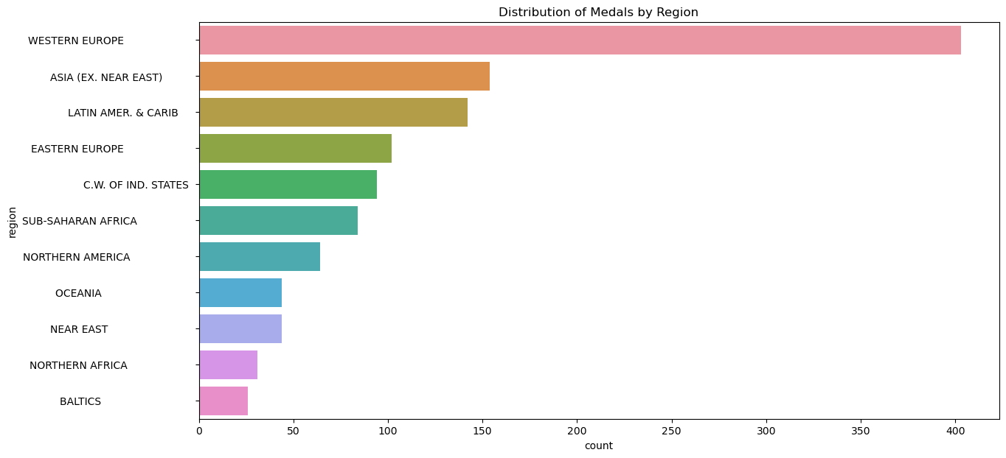
EDA
Notes:
Plot showing distribution of medals won by region
note: these are aggregate counts
western europe clearly dominates w/ highest medal count; notice how it has more than double the medals of #2 asia

Slide 9
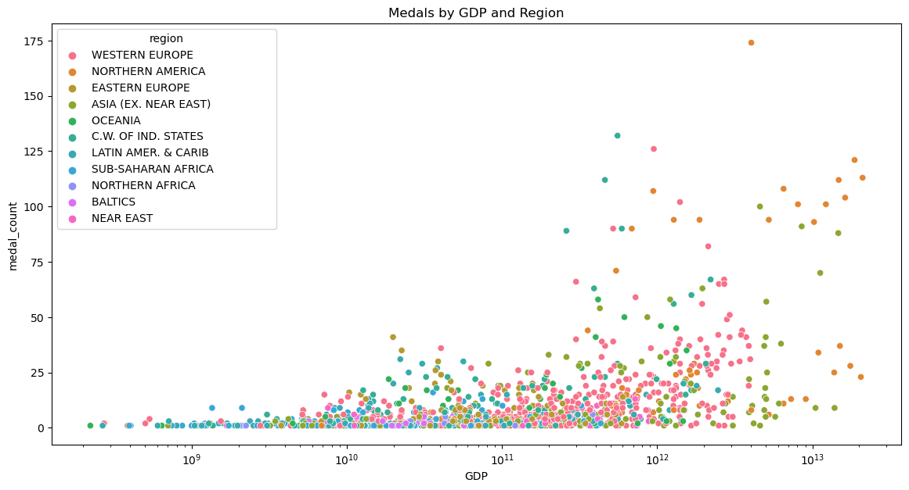
EDA
Notes:
Plot showing GDP vs. medals
it seems there is a positive association between the two; as a country’s GDP increases, so does the amount of medals they win

Slide 10
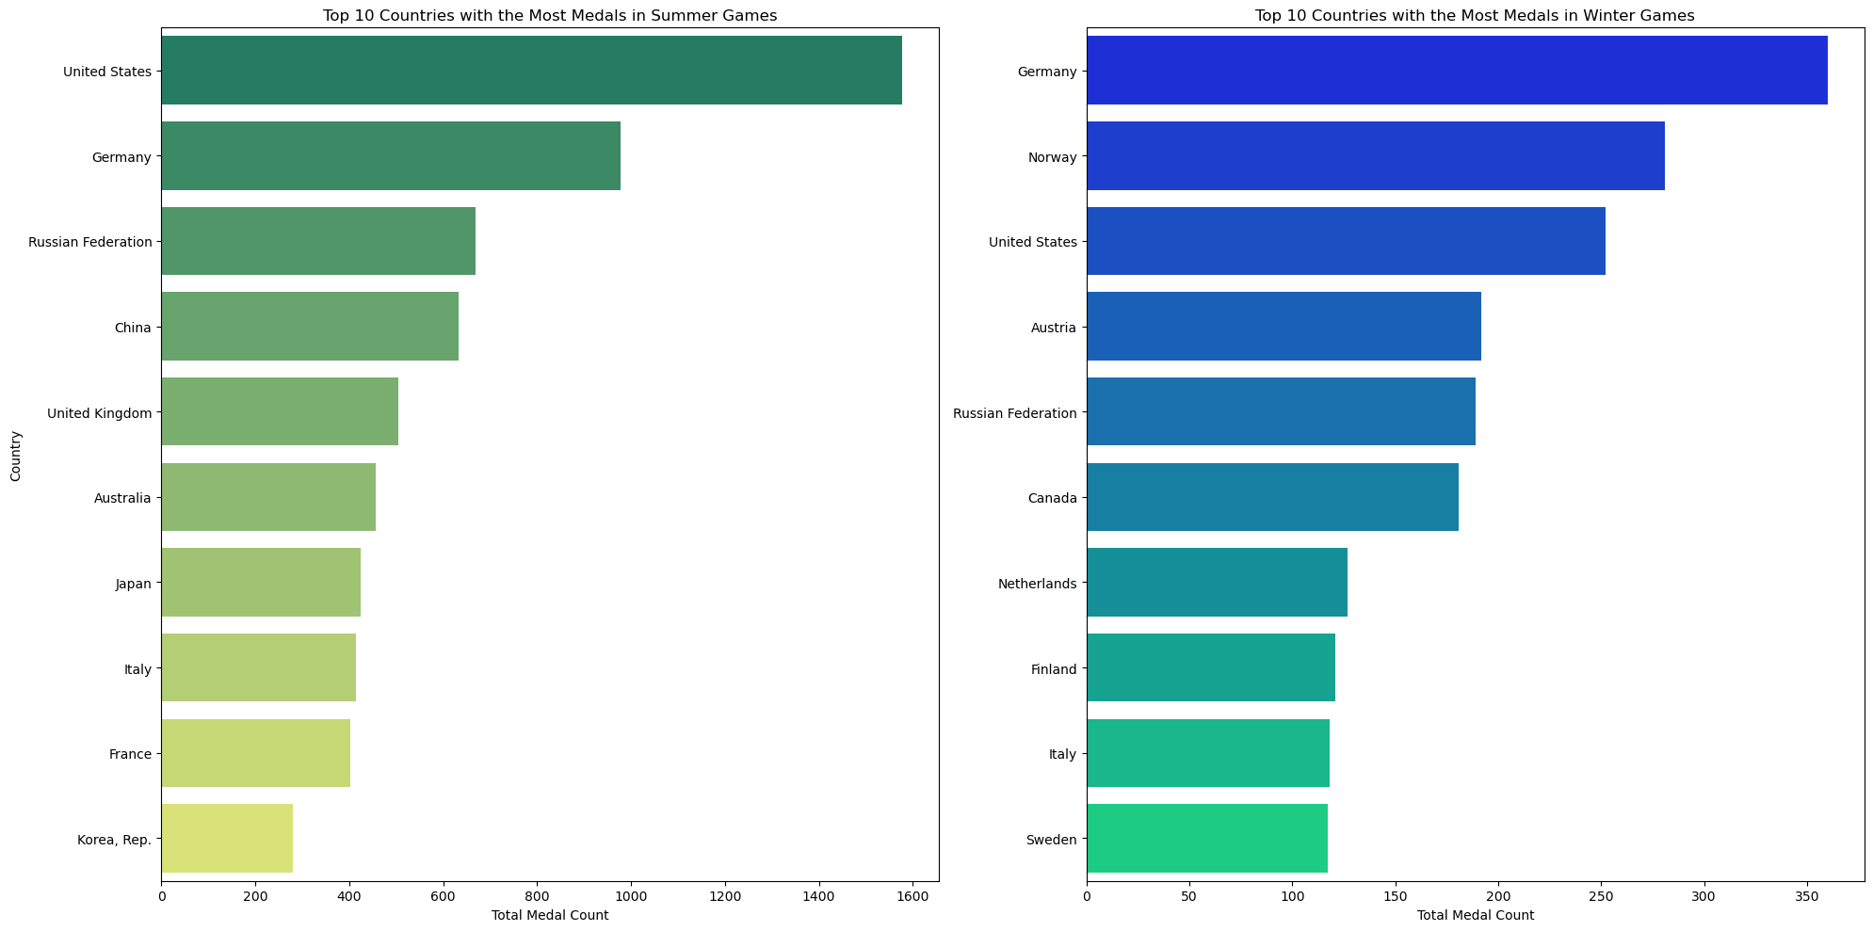
EDA
Notes:
Plot showing top 10 countries by medals across season
countries like usa, germany, & russian federation perform well in both seasons
across both, these countries are never out of top 5 (though rank shifts depending on season)
others like norway & austria have strong performances in winter games, while countries like china & korea excel more in the summer

Slide 11
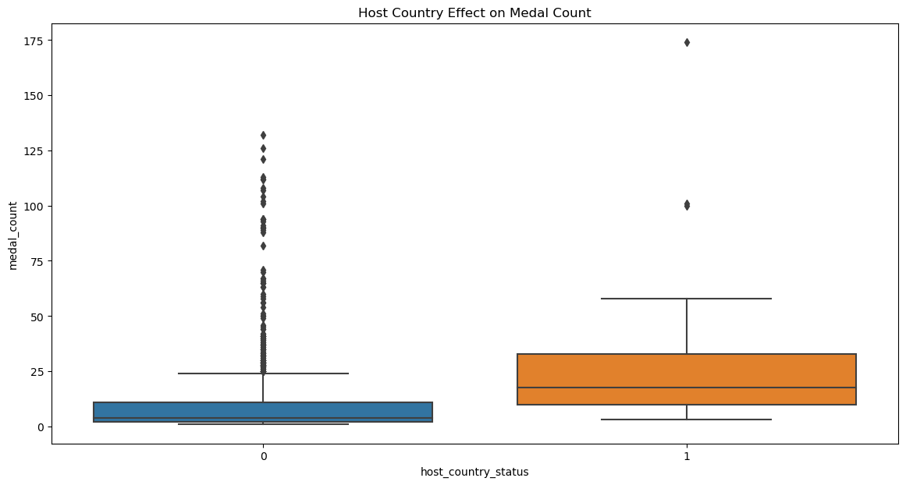
EDA
Notes:
Plot showing host status vs. medals
host countries (status= 1) generally have higher median medal counts compared to non-host countries (status= 0); but hosts exhibit a wider IQR, indicating more variability in the number of medals won
non-host countries tend to have a more compact distribution of medal counts, w/ fewer instances of extremely high medal counts
overall, suggesting that being the host country positively impacts the number of medals won, probably due to factors like home advantage, better prep, & increased investment in athletes + infrastructure

Slide 12
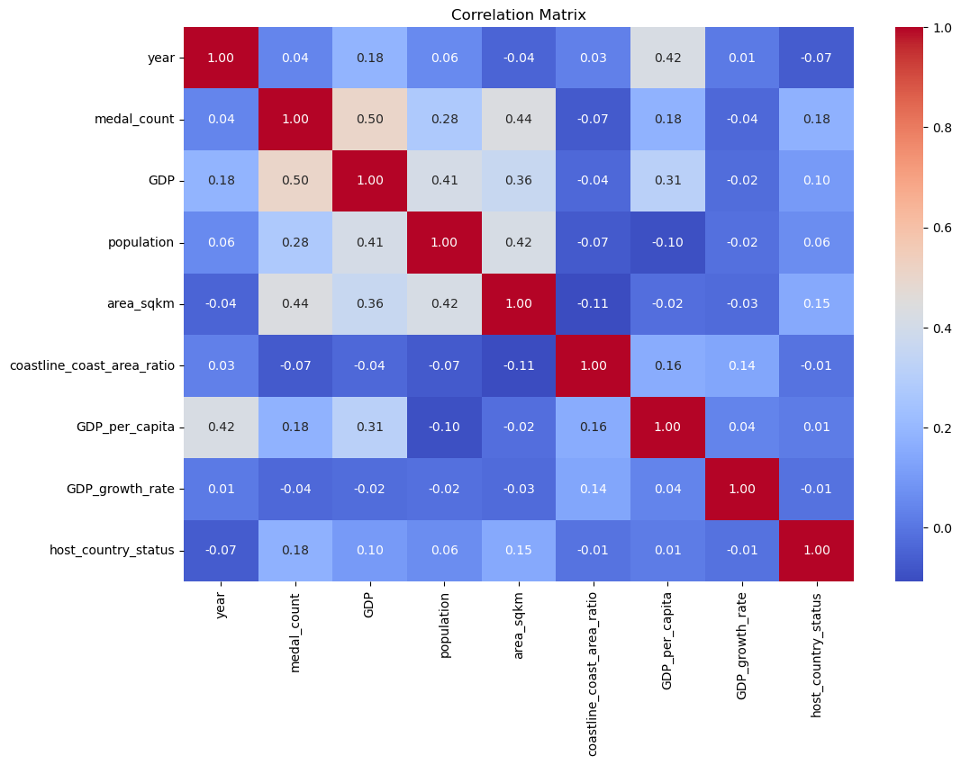
EDA
Notes:
Correlation matrix
not really what we wanted to see; most factors have minimal impact on predicting olympic success
we see VERY weak correlations; the only moderate positive correlation is between GDP & medal_counts
other slightly positive correlations are population & area_sqkm

Slide 13

3
Machine Learning Models

Slide 14
Models Overview
Decision Tree
Bagging
Random Forest
Gradient Boosting
Notes:
Correlation matrix
not really what we wanted to see; most factors have minimal impact on predicting olympic success
we see VERY weak correlations; the only moderate positive correlation is between GDP & medal_counts
other slightly positive correlations are population & area_sqkm

Slide 15
Summer Decision Tree Model
Evaluation Metrics
MAE: 7.785714
MSE: 224.551948
RMSE: 14.985057
R²: 0.322729
Notes:
Correlation matrix
not really what we wanted to see; most factors have minimal impact on predicting olympic success
we see VERY weak correlations; the only moderate positive correlation is between GDP & medal_counts
other slightly positive correlations are population & area_sqkm

Slide 16
Summer Bagging Model
Evaluation Metrics | Optimize Hyperparameters using Grid Search bootstrap: False bootstrap_features: False max_features: 0.7 max_samples: 0.7 n_estimators: 200 | Optimized Evaluation Metrics
MAE: 5.201948 |  | MAE: 4.794478
MSE: 85.332792 |  | MSE: 57.540310
RMSE: 9.237575 |  | RMSE: 7.585533
R²: 0.742628 |  | R²: 0.826453
Notes:
Correlation matrix
not really what we wanted to see; most factors have minimal impact on predicting olympic success
we see VERY weak correlations; the only moderate positive correlation is between GDP & medal_counts
other slightly positive correlations are population & area_sqkm

Slide 17
Summer Random Forest Model
Evaluation Metrics | Optimize Hyperparameters using Grid Search bootstrap: True max_depth: 20 max_features: sqrt min_samples_leaf: 1 min_samples_split: 2 n_estimators: 100 | Optimized Evaluation Metrics
MAE: 4.674238 |  | MAE: 4.507012
MSE: 52.975255 |  | MSE: 49.951581
RMSE: 7.278410 |  | RMSE: 7.067643
R²: 0.840221 |  | R²: 0.849341
Notes:
Correlation matrix
not really what we wanted to see; most factors have minimal impact on predicting olympic success
we see VERY weak correlations; the only moderate positive correlation is between GDP & medal_counts
other slightly positive correlations are population & area_sqkm

Slide 18
Summer Gradient Boosting Model
Evaluation Metrics | Optimize Hyperparameters using Grid Search learning_rate: 0.1 max_depth: 5 max_features: sqrt min_samples_leaf: 2 min_samples_split: 2 n_estimators: 250 subsample: 0.8 | Optimized Evaluation Metrics
MAE: 5.013585 |  | MAE: 4.538984
MSE: 66.179258 |  | MSE: 47.197012
RMSE: 8.135063 |  | RMSE: 6.870008
R²: 0.800397 |  | R²: 0.857649
Notes:
Correlation matrix
not really what we wanted to see; most factors have minimal impact on predicting olympic success
we see VERY weak correlations; the only moderate positive correlation is between GDP & medal_counts
other slightly positive correlations are population & area_sqkm

Slide 19
Summer Olympics Models Summary
 | MAE | MSE | RMSE | R²
Decision Tree | 7.786 | 224.552 | 14.985 | 0.323
Bagging | 5.202 | 85.333 | 9.238 | 0.743
Random Forest | 4.674 | 52.975 | 7.278 | 0.840
Gradient Boosting | 5.014 | 66.179 | 8.135 | 0.800
Optimized Bagging | 4.794 | 57.540 | 7.586 | 0.826
Optimized Random Forest | 4.507 | 49.951 | 7.068 | 0.849
Optimized Gradient Boosting | 4.539 | 47.197 | 6.870 | 0.858
Notes:
Correlation matrix
not really what we wanted to see; most factors have minimal impact on predicting olympic success
we see VERY weak correlations; the only moderate positive correlation is between GDP & medal_counts
other slightly positive correlations are population & area_sqkm

Slide 20
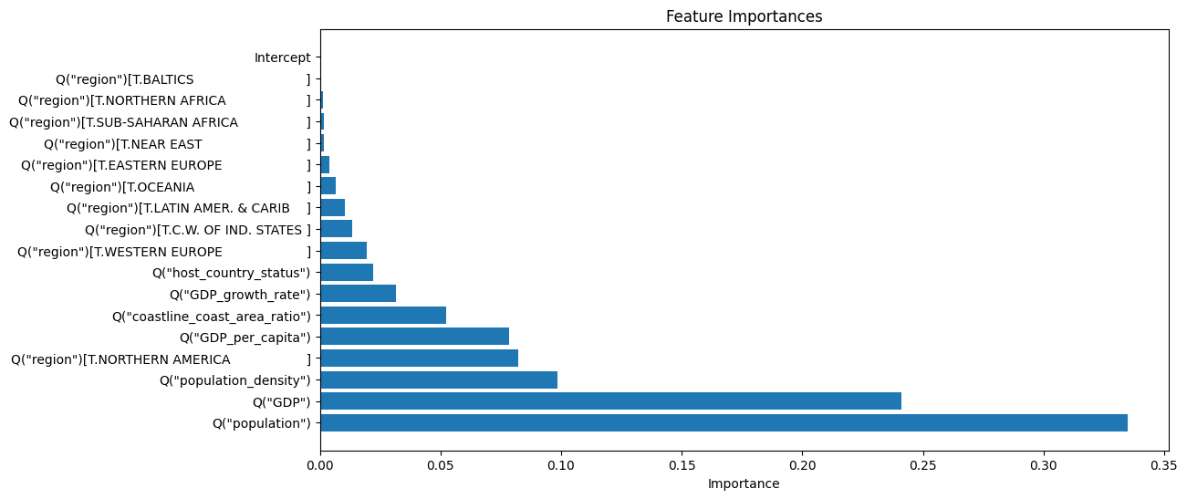
Summer Olympics Models Feature Importance
Notes:
Correlation matrix
not really what we wanted to see; most factors have minimal impact on predicting olympic success
we see VERY weak correlations; the only moderate positive correlation is between GDP & medal_counts
other slightly positive correlations are population & area_sqkm

Slide 21
Winter Decision Tree Model
Evaluation Metrics
MAE: 5.224138
MSE: 49.396552
RMSE: 7.028268
R²: 0.484955
Notes:
Correlation matrix
not really what we wanted to see; most factors have minimal impact on predicting olympic success
we see VERY weak correlations; the only moderate positive correlation is between GDP & medal_counts
other slightly positive correlations are population & area_sqkm

Slide 22
Winter Bagging Model
Evaluation Metrics | Optimize Hyperparameters using Grid Search bootstrap: False bootstrap_features: False max_features: 1.0 max_samples: 0.7 n_estimators: 100 | Optimized Evaluation Metrics
MAE: 3.950000 |  | MAE: 3.884483
MSE: 30.017759 |  | MSE: 30.226231
RMSE: 5.478846 |  | RMSE: 5.497839
R²: 0.687013 |  | R²: 0.684839
Notes:
Correlation matrix
not really what we wanted to see; most factors have minimal impact on predicting olympic success
we see VERY weak correlations; the only moderate positive correlation is between GDP & medal_counts
other slightly positive correlations are population & area_sqkm

Slide 23
Winter Random Forest Model
Evaluation Metrics | Optimize Hyperparameters using Grid Search bootstrap: False max_depth: 20 max_features: sqrt min_samples_leaf: 1 min_samples_split: 2 n_estimators: 200 | Optimized Evaluation Metrics
MAE: 4.059540 |  | MAE: 3.615690
MSE: 31.426216 |  | MSE: 27.948496
RMSE: 5.605909 |  | RMSE: 5.286634
R²: 0.672327 |  | R²: 0.708588
Notes:
Correlation matrix
not really what we wanted to see; most factors have minimal impact on predicting olympic success
we see VERY weak correlations; the only moderate positive correlation is between GDP & medal_counts
other slightly positive correlations are population & area_sqkm

Slide 24
Winter Gradient Boosting Model
Evaluation Metrics | Optimize Hyperparameters using Grid Search learning_rate: 0.1 max_depth: 3 max_features: sqrt min_samples_leaf: 4 min_samples_split: 2 n_estimators: 250 subsample: 0.8 | Optimized Evaluation Metrics
MAE: 4.152153 |  | MAE: 3.675121
MSE: 32.578276 |  | MSE: 28.368045
RMSE: 5.707738 |  | RMSE: 5.326166
R²: 0.660315 |  | R²: 0.704214
Notes:
Correlation matrix
not really what we wanted to see; most factors have minimal impact on predicting olympic success
we see VERY weak correlations; the only moderate positive correlation is between GDP & medal_counts
other slightly positive correlations are population & area_sqkm

Slide 25
Winter Olympics Models Summary
 | MAE | MSE | RMSE | R²
Decision Tree | 5.224 | 49.397 | 7.028 | 0.485
Bagging | 3.950 | 30.018 | 5.479 | 0.687
Random Forest | 4.060 | 31.426 | 5.606 | 0.672
Gradient Boosting | 4.152 | 32.578 | 5.708 | 0.660
Optimized Bagging | 3.884 | 30.226 | 5.498 | 0.684
Optimized Random Forest | 3.616 | 27.948 | 5.287 | 0.709
Optimized Gradient Boosting | 3.675 | 28.368 | 5.326 | 0.704
Notes:
Correlation matrix
not really what we wanted to see; most factors have minimal impact on predicting olympic success
we see VERY weak correlations; the only moderate positive correlation is between GDP & medal_counts
other slightly positive correlations are population & area_sqkm

Slide 26
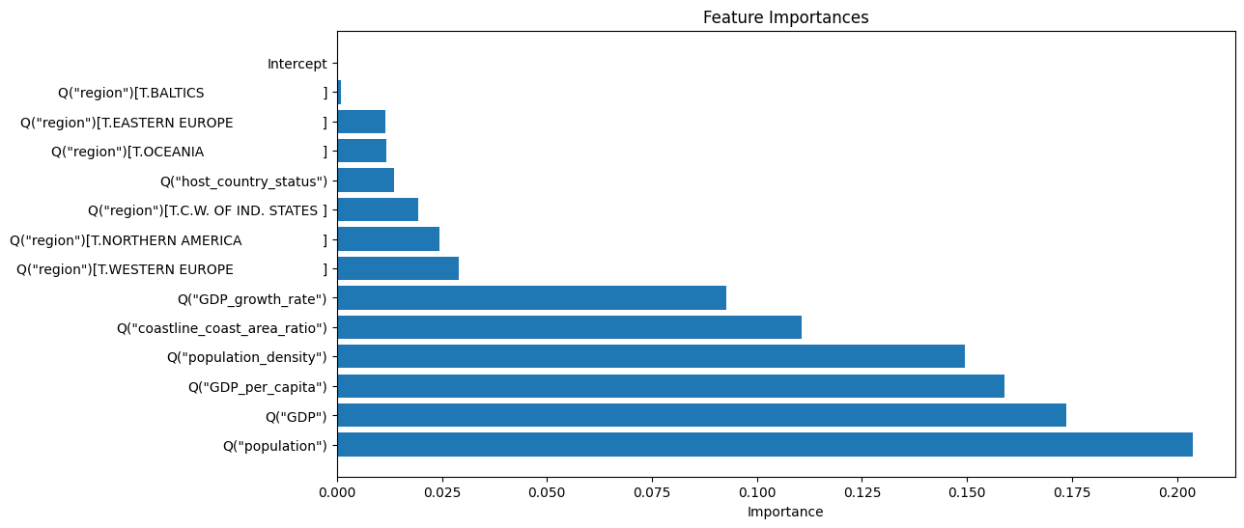
Winter Olympics Models Feature Importance
Notes:
Correlation matrix
not really what we wanted to see; most factors have minimal impact on predicting olympic success
we see VERY weak correlations; the only moderate positive correlation is between GDP & medal_counts
other slightly positive correlations are population & area_sqkm

Slide 27
Can our model predict how many medals the US will bring home in 2024?

Slide 28
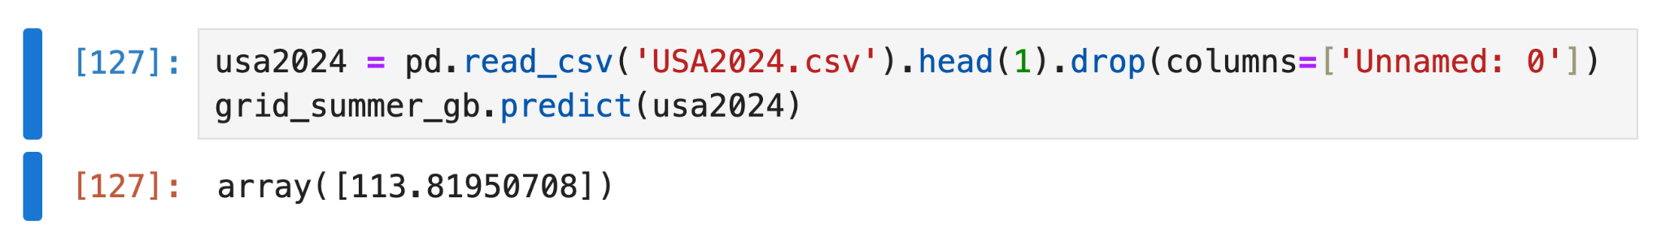
Our prediction:
(from the Summer optimized gradient boosting model)
114 medals!
🥇🥈🥉🦅🦅🇺🇸🇺🇸

Slide 29

Conclusion
GDP and Population are the most predictors
Limitations
we weren’t able to take into account a country’s cultural emphasis on sports or other economic indicators besides GDP

Slide 30
Thanks for listening! Any questions?

